Slide 1
Covariance Matrix

Slide 2
Outline
Mean/Center of Mass
Variance
Covariance
Covariance Matrix

Slide 4
Center of mass/Mean

Slide 5
Center of mass/Mean
x-variance

Slide 6
Center of mass/Mean
y-variance
x-variance

Slide 7
Center of mass/Mean
covariance
y-variance
x-variance

Slide 8

400
300
Size
200
100
1
2
3
4
5
Number of Rooms

Slide 9
400
300
Size
200
100
1
2
3
4
5
Number of Rooms

Slide 10
400
300
Size
200
100
1
2
3
4
5
Number of Rooms

Slide 11
400
300
Size
200
100
1
2
3
4
5
Number of Rooms

Slide 13
1 dimension

Slide 14
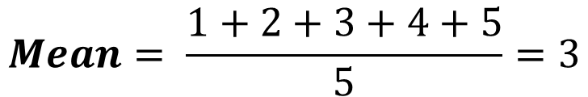
Mean
House A
House B
House C
House D
House E
1
2
3
4
5
$$Mean= \frac{1+2+3+4+5}{5}=3$$
House C is the mean

Slide 15
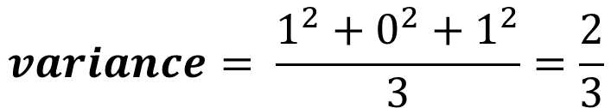
Variance
House B and House D is 1 point away from the mean
House B
1
House C
1
House D
$$variance= \frac{1^{2}+0^{2}+1^{2}}{3}=\frac{2}{3}$$

Slide 16
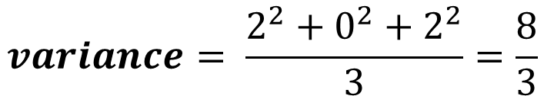
Variance
House A and House E is 2 points away from the mean
House B
1
House C
1
House D
$$variance= \frac{1^{2}+0^{2}+1^{2}}{3}=\frac{2}{3}$$
House E
House A
2
House C
2
$$variance= \frac{2^{2}+0^{2}+2^{2}}{3}=\frac{8}{3}$$

Slide 17
How about the variance for two-dimensional data? Can we use the same method?

Slide 18
For two-dimensional data, we need to get the variance of the x-axis….

Slide 19
And the of the y-axis

Slide 20
And the of the y-axis

Slide 21
But there will be datasets that are different but will have the same x-variance and y-variance.

Slide 22
2
2
2
2
1
1
1
1
Look at these two datasets. If you notice they are different from each other, but they will have the same x-variance and y-variance.

Slide 23
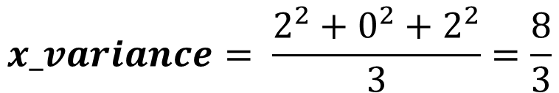
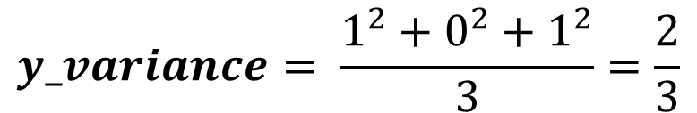
2
2
2
2
1
1
1
1
$$x_variance= \frac{2^{2}+0^{2}+2^{2}}{3}=\frac{8}{3}$$
$$y_variance= \frac{1^{2}+0^{2}+1^{2}}{3}=\frac{2}{3}$$

Slide 24
2
2
2
2
1
1
1
1
These two data sets have the same x-variance and y-variance but they are fundamentally different.

Slide 25
2
2
2
2
1
1
1
1
Is there another metric to tell us that these two are different?
Yes! Its called covariance

Slide 26
Covariance
Covariance is a measure of the joint variability of two random variables.^{[1]}

Slide 27









$$\left(−2,1\right)$$
$$\left(2,1\right)$$
$$−2$$
$$+2$$
$$\left(0,0\right)$$
$$\left(−2,−1\right)$$
$$\left(−2,1\right)$$
$$+2$$
$$−2$$

Slide 28

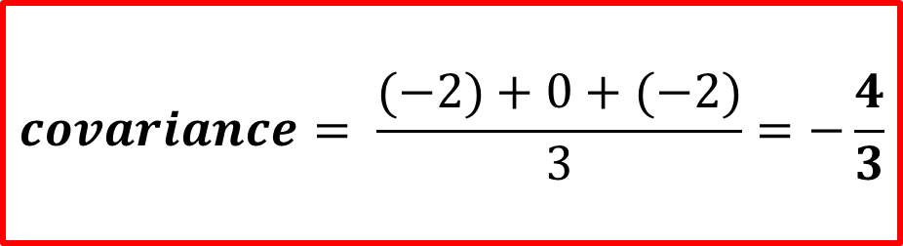









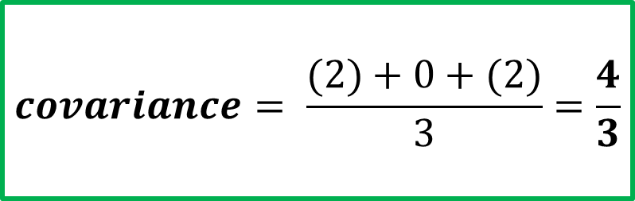
$$\left(−2,1\right)$$
$$\left(2,1\right)$$
$$−2$$
$$+2$$
$$\left(0,0\right)$$
$$\left(0,0\right)$$
$$\left(−2,1\right)$$
$$\left(−2,−1\right)$$
$$−2$$
$$+2$$
$$covariance= \frac{(−2)+0+(−2)}{3}=−\frac{4}{3}$$
$$covariance= \frac{(2)+0+(2)}{3}=\frac{4}{3}$$

Slide 29
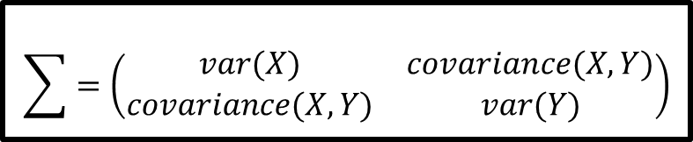
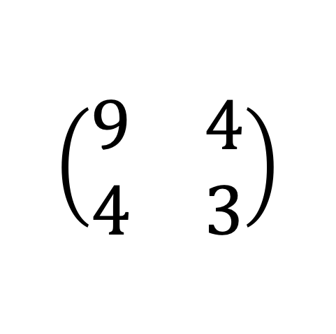
$$\sum{=\left(\begin{matrix}var(X) & covariance(X,Y) \\ covariance(X,Y) & var(Y)\end{matrix}\right)}$$
$$\left(\begin{matrix}9 & 4 \\ 4 & 3\end{matrix}\right)$$

Slide 30
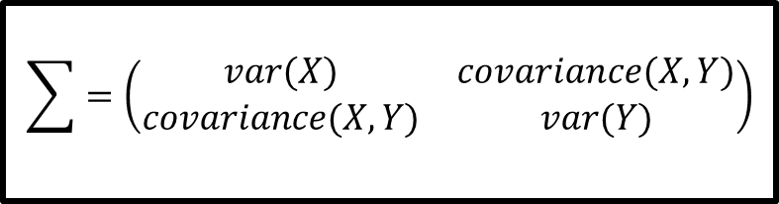
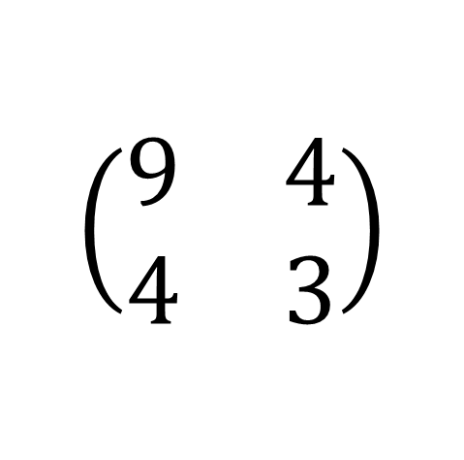
Covariance Matrix
$$\sum{=\left(\begin{matrix}var(X) & covariance(X,Y) \\ covariance(X,Y) & var(Y)\end{matrix}\right)}$$
$$\left(\begin{matrix}9 & 4 \\ 4 & 3\end{matrix}\right)$$

Slide 31
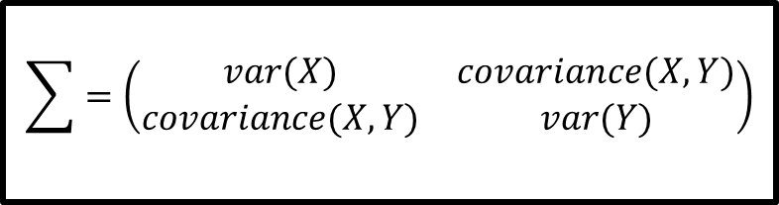
Covariance Matrix
$$\sum{=\left(\begin{matrix}var(X) & covariance(X,Y) \\ covariance(X,Y) & var(Y)\end{matrix}\right)}$$

Slide 32
Covariance Matrix
The covariance matrix is a square matrix with diagonal elements that represent the variance and the non-diagonal components that express covariance.
$$\sum{=\left(\begin{matrix}var(X) & covariance(X,Y) \\ covariance(X,Y) & var(Y)\end{matrix}\right)}$$

Slide 33




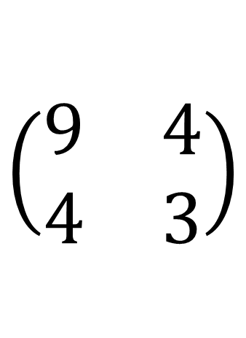








$$\left(\begin{matrix}9 & 4 \\ 4 & 3\end{matrix}\right)$$
$$(x,y)$$
$$(9x+4y, 4x+3y)$$
$$(0,0)$$
$$(9,4)$$
$$(1,0)$$
$$(4,3)$$
$$(0,1)$$
$$(4,3)$$
$$(−1,0)$$
$$(−9,−4)$$
$$(0,−1)$$
$$(−4,−3)$$

